Slide 1
Data Science
Joey.Cheng

Slide 2
Outline
Introduction of data science
What is data science?
Example: recommendation system
Example: Whos call
Practical cases
PTT mobile phone and user analysis
Kaggle Titanic

Slide 3
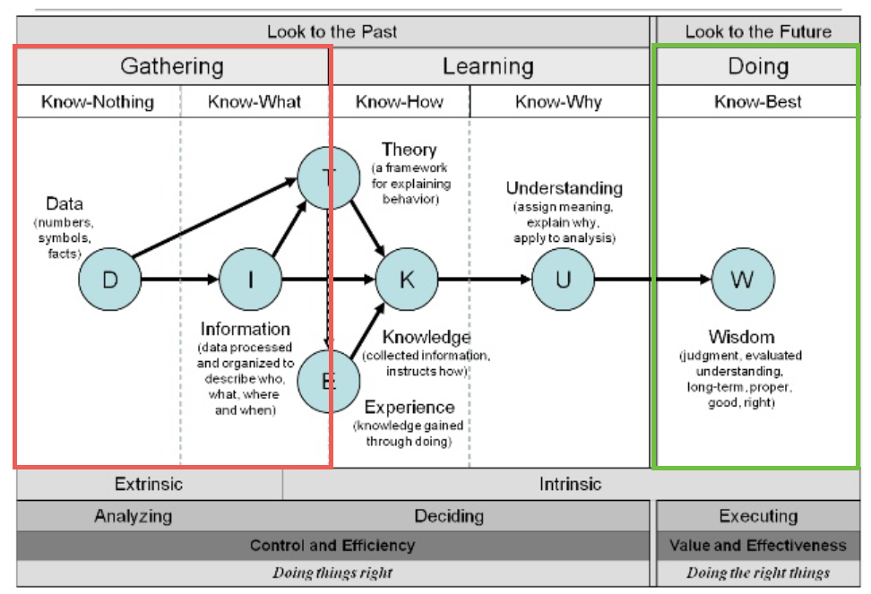
What is data science?

Slide 4
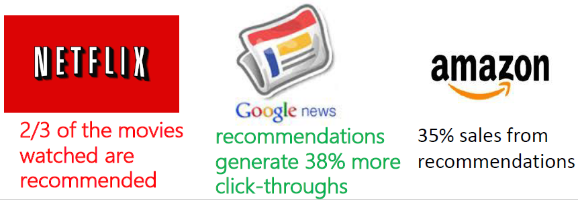
What is recommendation system
A recommendation system suggests potentially favored items or contents to users.

Slide 5
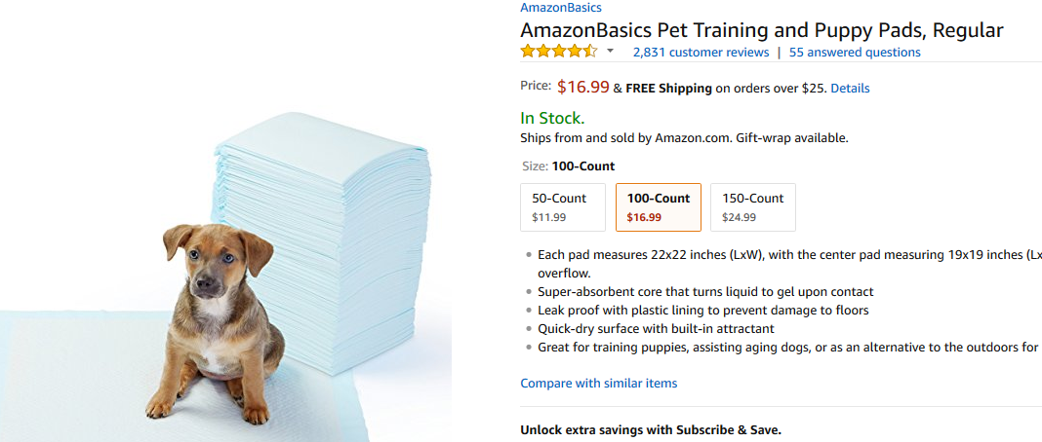
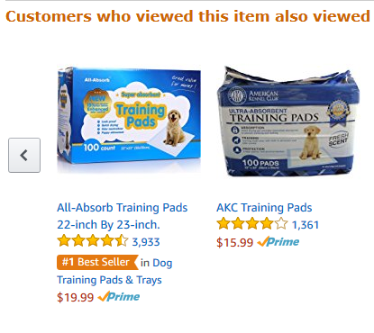
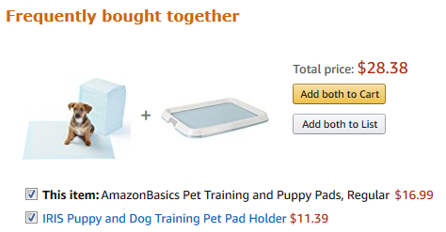
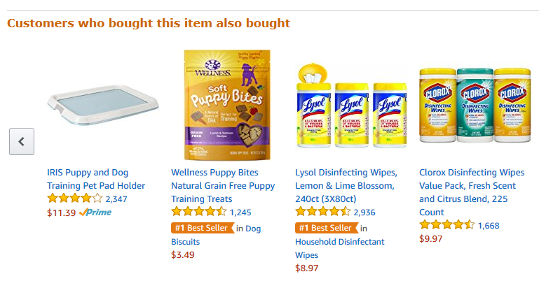
Amazon recommendation system

Slide 6
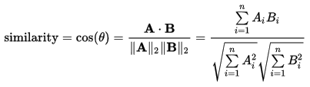
Collaborative Filtering
CF is the most successfully and common approach to generate recommendations
Key idea
Recommend the favored items of people who are similar to you
Need to collect the taste of other people
Cosine similarity

Slide 7
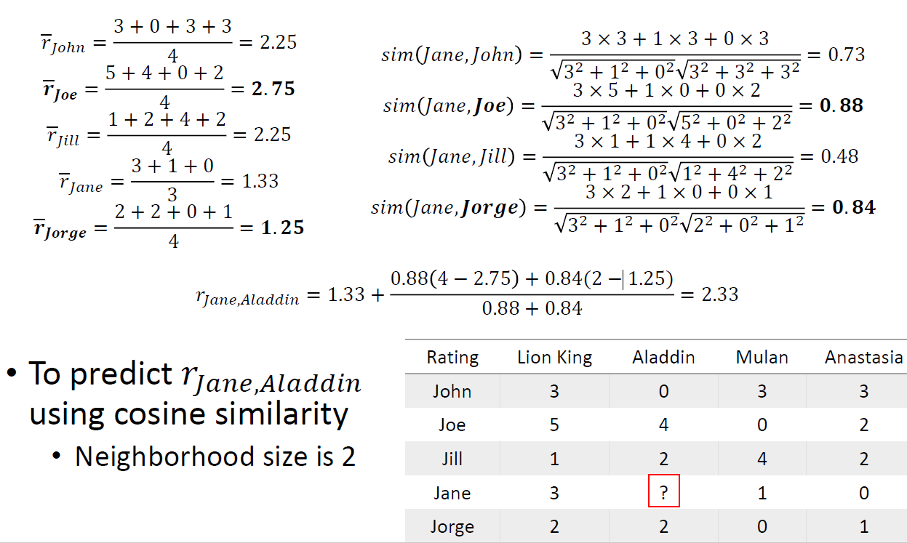
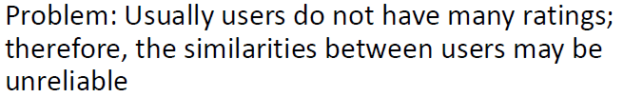
User based CF

Slide 8
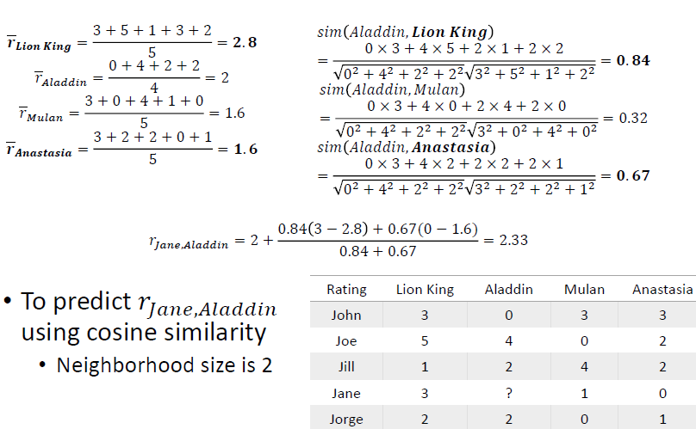
Item based CF

Slide 9

Whos call
400M phone calls per month database
3000 Spammer numbers are reported every day
3 of every 5 calls can be identified successfully

Slide 10
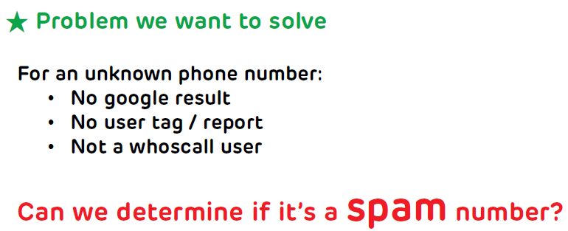
Whos call’s data science

Slide 11
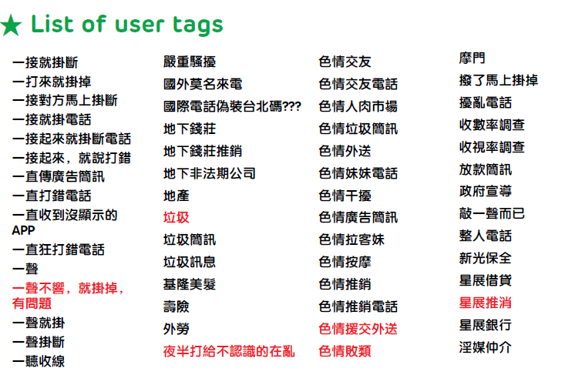
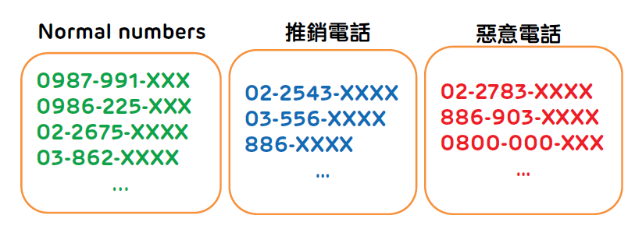
Call tagging

Slide 12
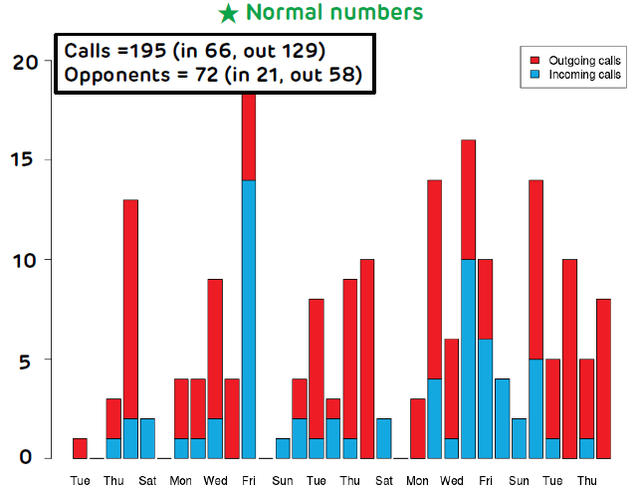
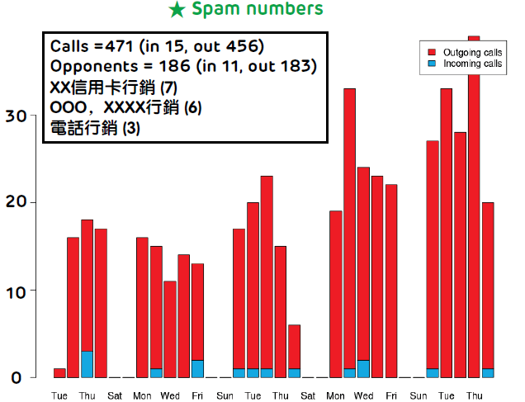
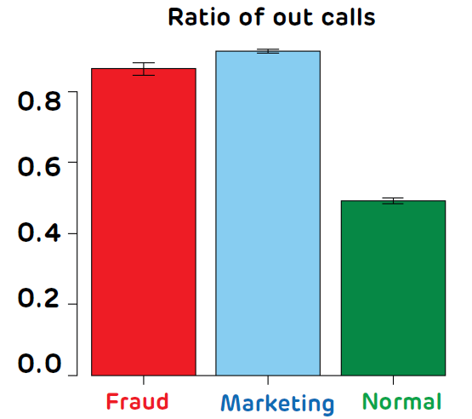
Call features

Slide 13
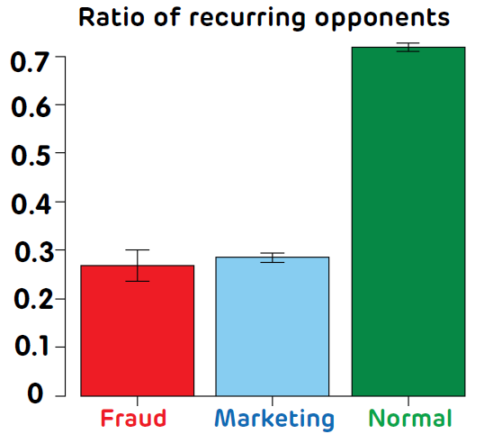
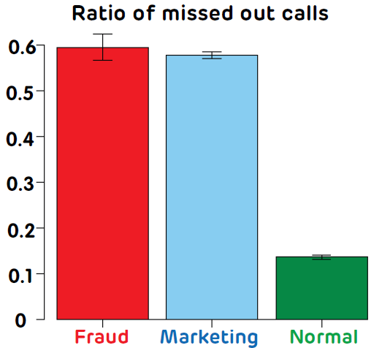
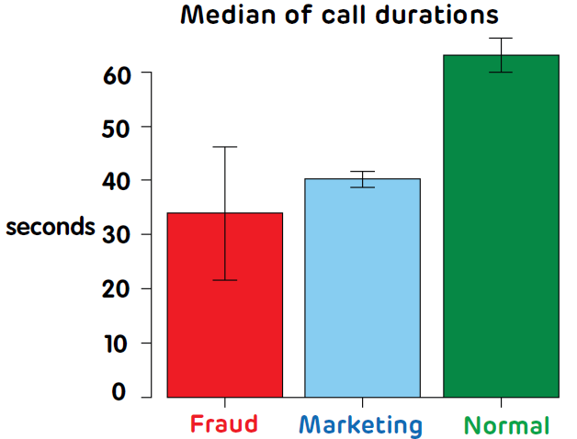
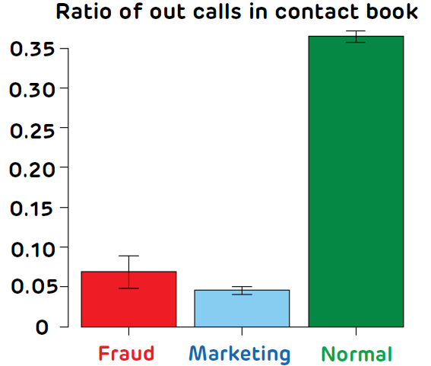
Call features(cont.)

Slide 14

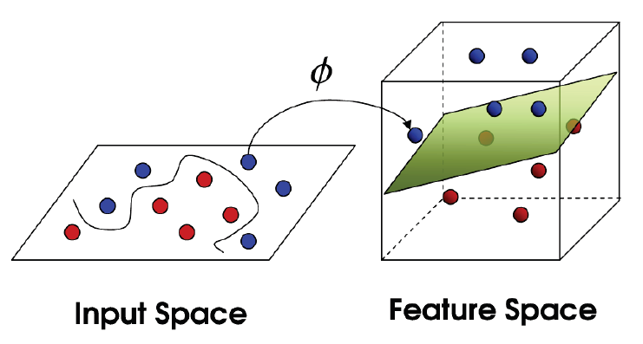
Support vector machine

Slide 15
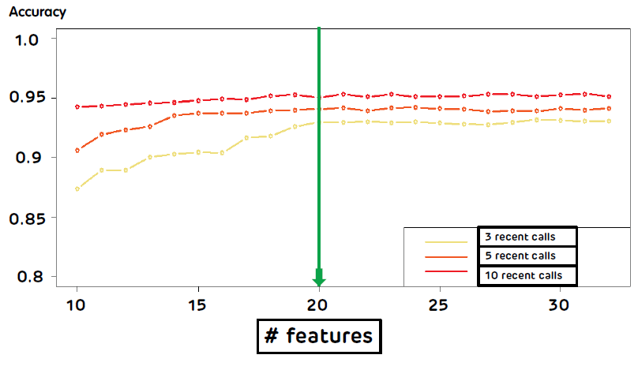
Optimization
Reduce features to make all calculation below 0.5

Slide 16
PTT mobile board analysis
Targets
Find hot words for different bands.
Find users preference vertically and horizontally.
All examples are at: Link
Collect data by web crawler
Jieba key word analysis
User analysis
Classify data
Collect more data and predict its category

Slide 17
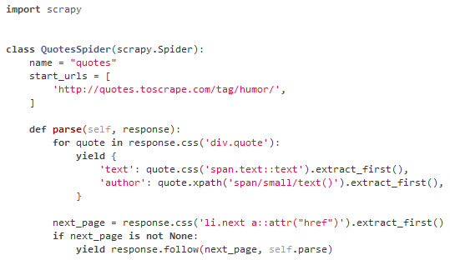
Web crawler
Scrapy: Easy to use and understand.
Execution

Slide 18
Classify data
Crawler output file example
Link
{"negative_count": "0",
"brand":"sony“,
"title": "[問題] 想買SONY XA1但是....值得嗎？",
"positive_user": ["Lumia625 ", "jasn4560 ", "cutekenny ", "ak77now ", "james732 ", "IloveZ ", "xperiaxa ", "james850803 ", "alien818 ", "bird09 ", "hanmajor ", "Alano ", "Abigo ", "adple123 ", "rinppi ", "FeRin "],
"date": " 4/04",
"author": "adple123",
"positive_count": "10",
"content": ["\n是這樣的\n\n小弟最近看到SONY XA1感覺還不錯\n\n有點換換病發作\n\n目前我是用紅米NOTE3 特製版\n\n使用上是完全沒有任何不愉快\n\n除了相機在室內拍照有點小悲劇外 XD\n\n\n真的只是想換新手機而已\n\n請問從紅米跳到XA1值得嗎？\n\n我比較care的點是，XA1的螢幕只有720P\n\n不知道在使用上有沒有差？\n\n--\n"],
"content_url": "/bbs/MobileComm/M.1491279686.A.A24.html",
"negative_user": []}

Slide 19
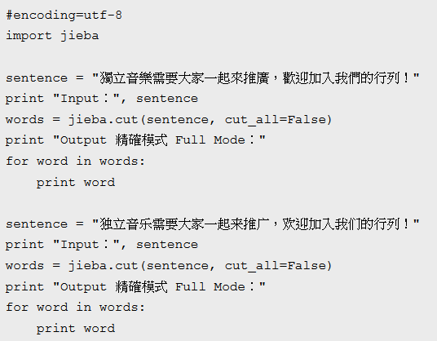
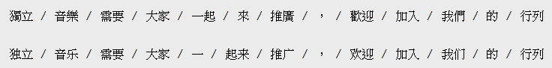
JIEBA word extraction
Code
Result

Slide 20
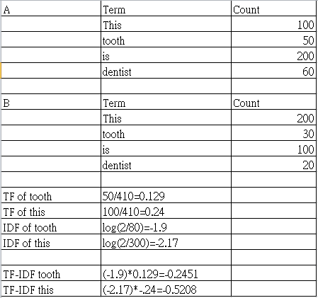
TFIDF keyword analysis
詞頻 (term frequency, TF) 指的是某一個給定的詞語在該文件中出現的次數
逆向文件頻率 (inverse document frequency, IDF) 總文件數目除以包含該詞語之文件的數目，再將得到的商取對數
The keywords which were found by TFIDF could be used as a basis for classifying articles.

Slide 21
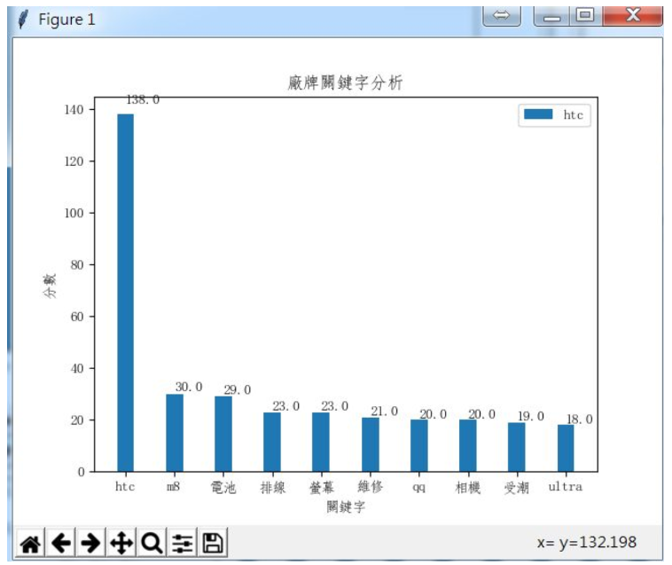
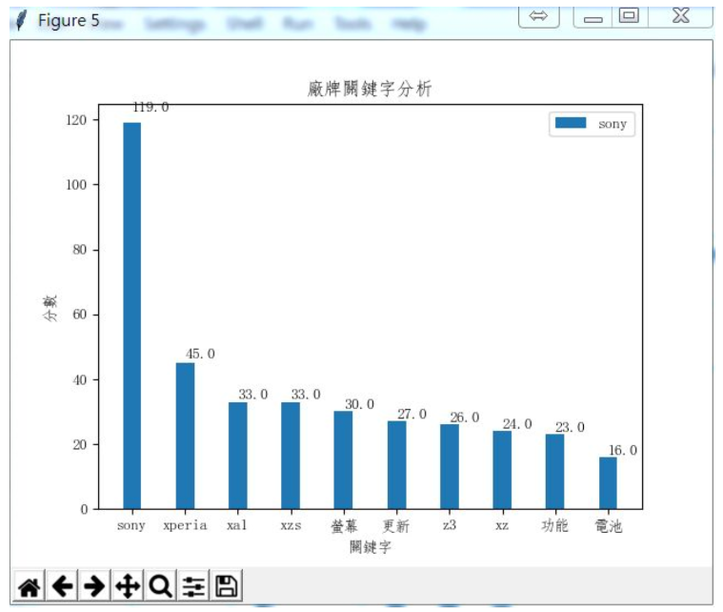
Brand Keyword example

Slide 22
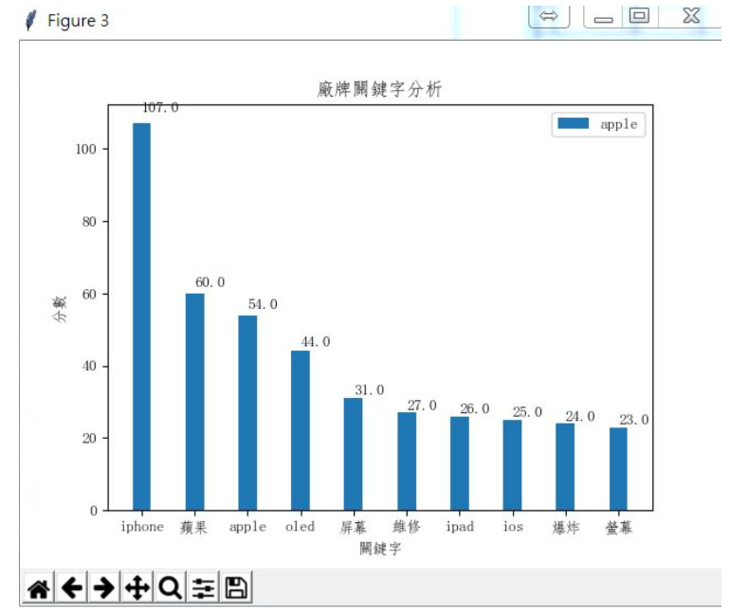
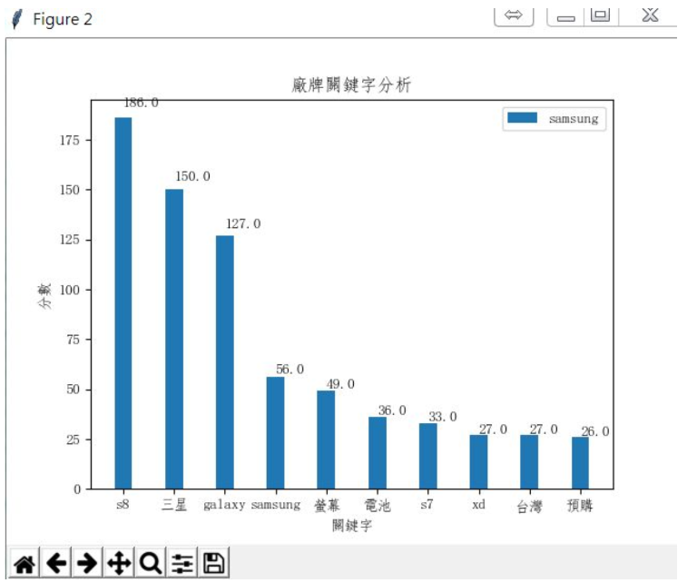
Brand Keyword example(Cont.)
More..

Slide 23
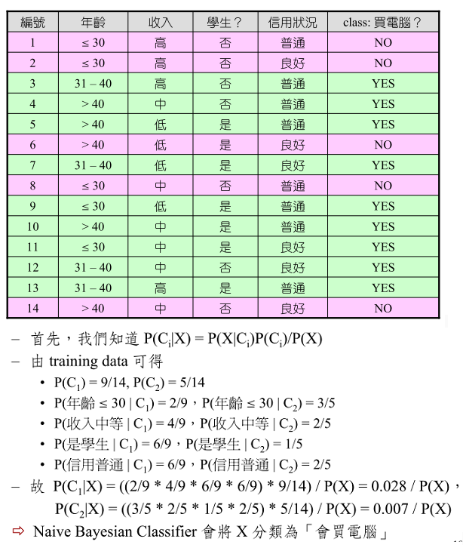
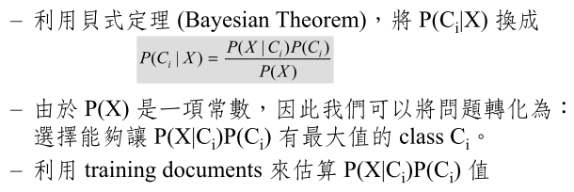
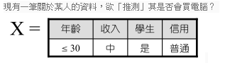
Naïve Bayesian

Slide 24
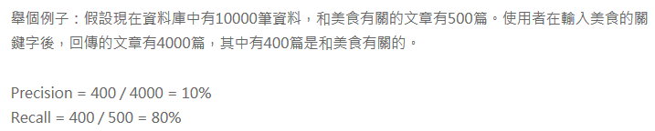
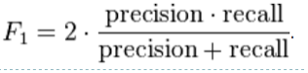
Classify article
Calculate TFIDF for each trained data and a category will be given.
Use NB to predict test data’s category
Link
Prediction evaluation: Precision, Recall, F-Score
F1=0.17

Slide 25
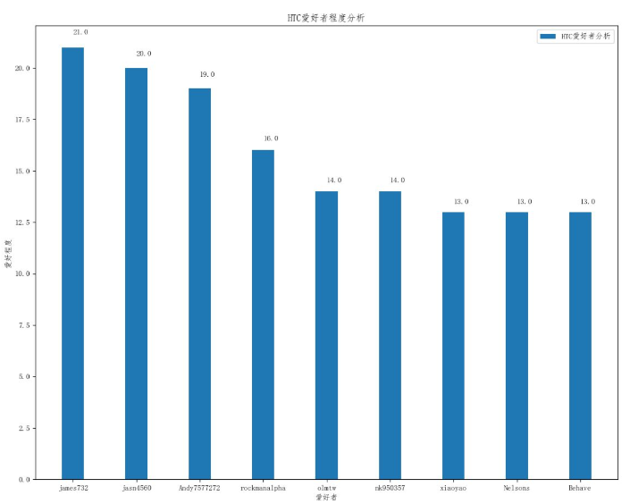
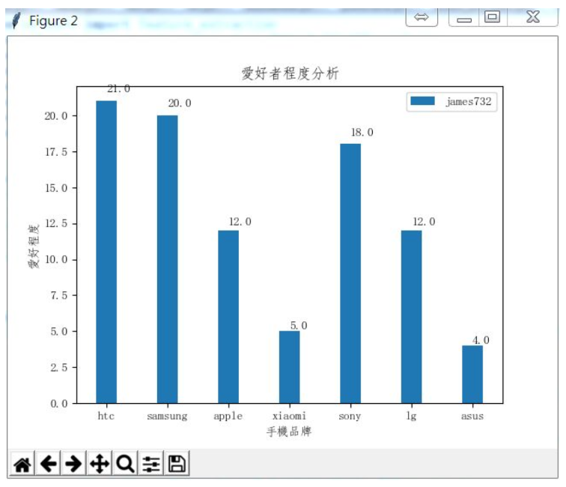
User analysis
Vertical and horizontal analysis for target user

Slide 26
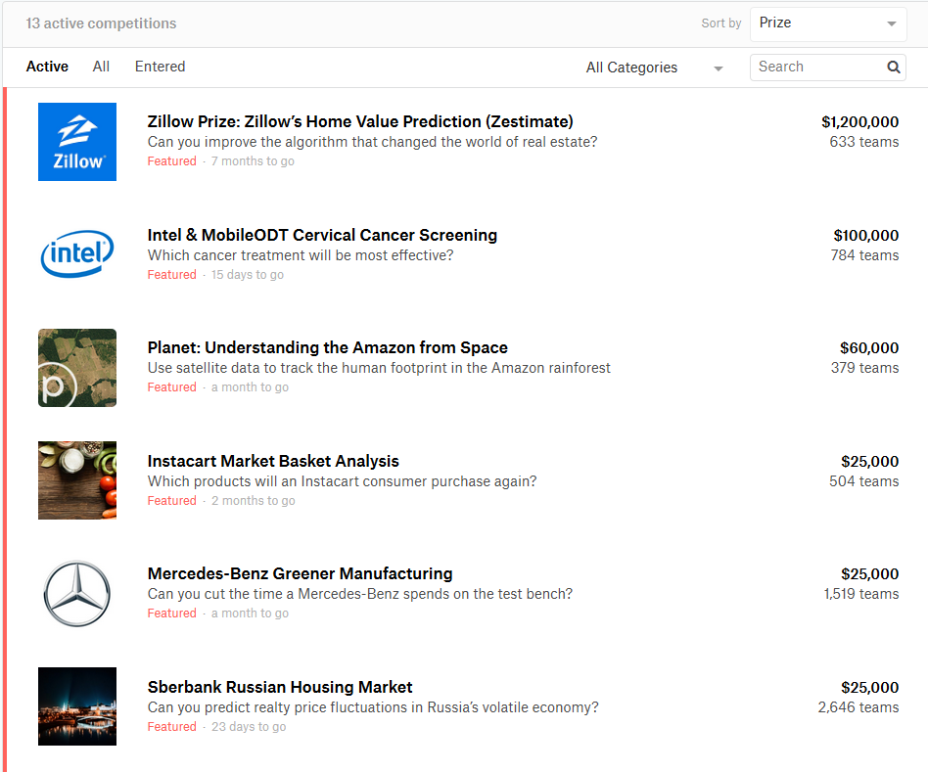
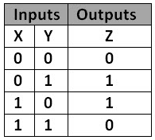
Kaggle
A data science competition site which is acquired by Google this year
Many competitions are give with huge rewards.
Positive: new ML, paper
Negative: reverse hacking
Ans1:X xor Y
Ans2: if (x==1 && y==0) || (x==0 && y==1)
Ans2 is a reverse hacking example

Slide 27
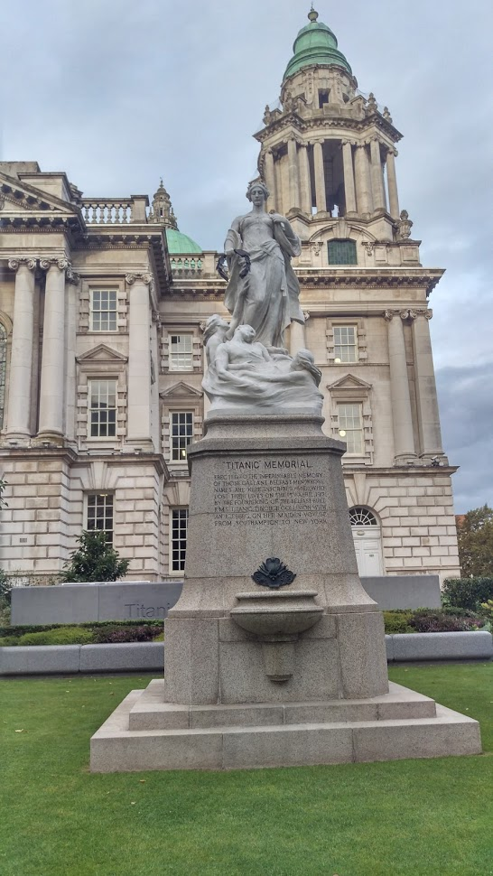
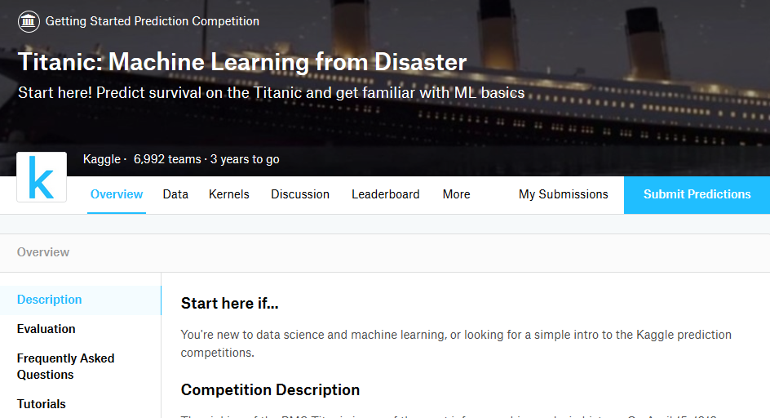
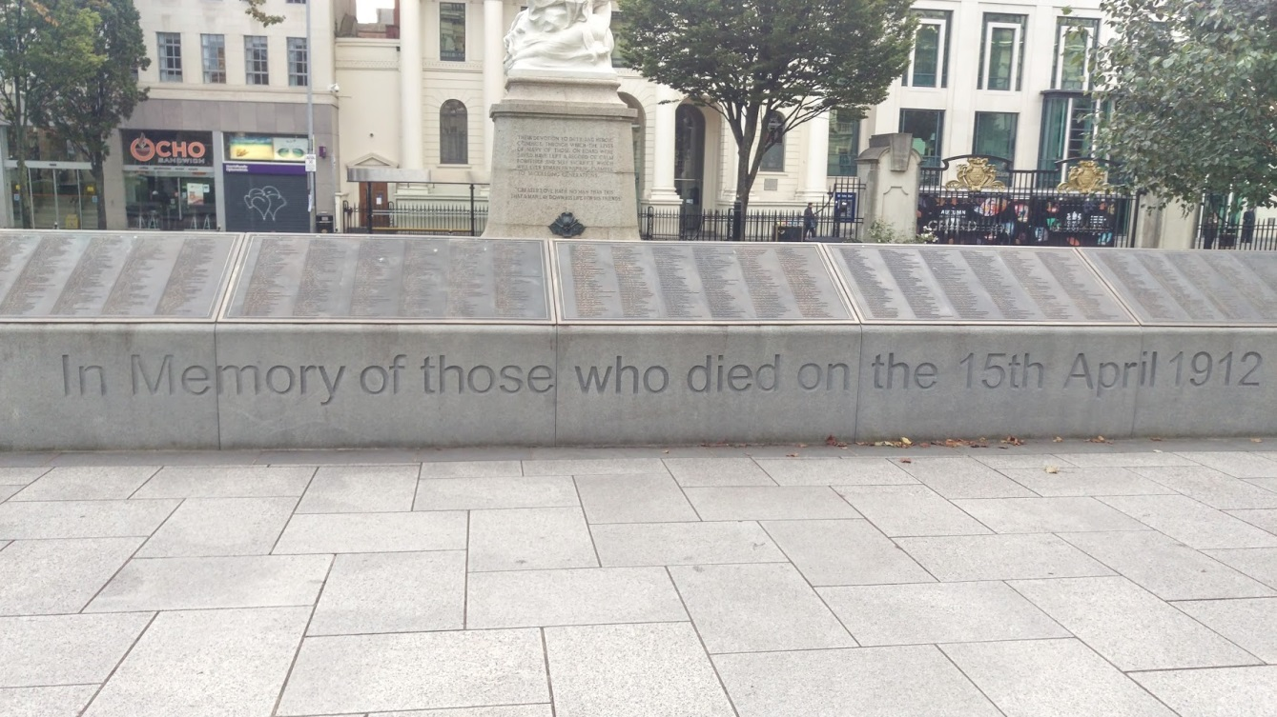
Titanic

Slide 28
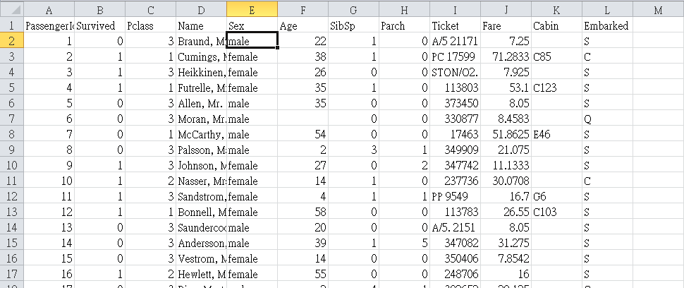
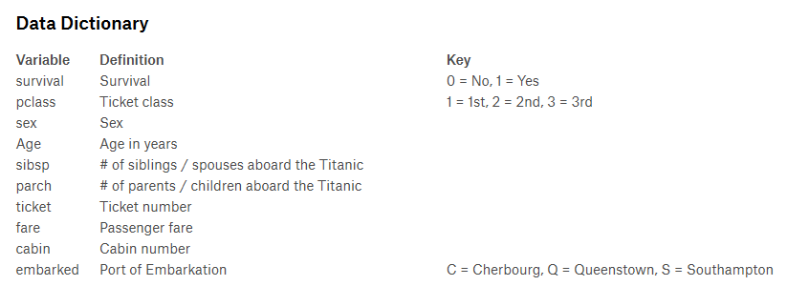
Titanic data sheet

Slide 29
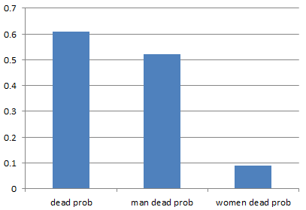
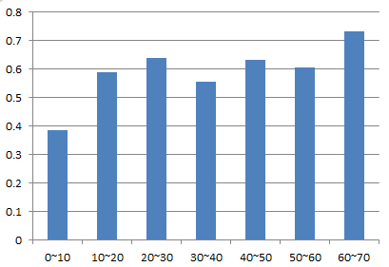
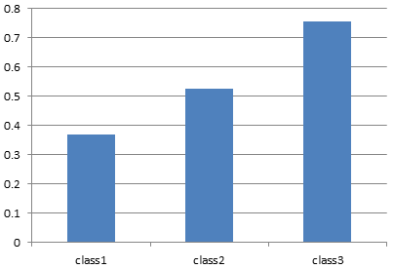
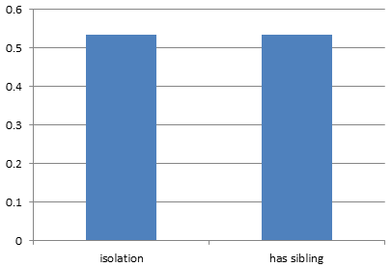
Column attribute analysis

Slide 30
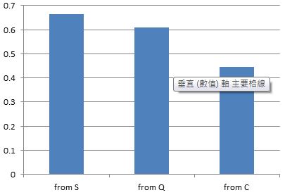
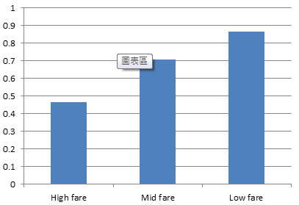
Column attribute analysis(Cont.)
Some important ideas for data analysis
Drop NULL value or make assumption for that column
Choose columns which have changes in result.(Decision factor)

Slide 31
ML flow of Titanic
Split test and train set(70%,30%)
Unified data value(1~3)
Drop NULL and unused columns
Train and prediction
Data unified rules:
Sex:male:1 female:2
Age:0~20,20~50,>50
Fare: <7.3,7.3~17,>17
Embarked: S:1 Q:2 C:3
Code is here

Slide 32

Training model evaluation
SVC f1 score: 0.762643239114
KNN f1 score: 0.803952274422
GussianNB f1 score: 0.779974959493
Perception f1 score: 0.746988914411
Decision tree f1 score: 0.790651377608
random forest f1 score: 0.789270529224

Slide 33
Thanks but it is not over
I hope this presentation could rise your interest of data science. CSIE graduates can spend more time on it. It has future.
Some of the topics like deep learning will be addressed in the future.
All courses video I put on /011/data_science

